Slide 1
Secrets Management
HLD, Use cases and products review
Roger Carhuatocto
v1.1

Slide 2

1. HLD, key components
Kubernetes (node worker)
1. Secrets Management Server.
It’s the Storage, it persists the secrets securely.
Key features are exposed as API.
2. Config Library (Monolith App).
Generally it loads the configuration (i.e. Java Properties/Config libs) and secrets into Application.
Advanced Libraries (i.e. Spring Cloud Config) can retrieve config and secrets from remote store and load them into Application memory automatically.
3. Sidecar (Container-based App).
Like Config Library, it authenticates its Container, retrieves the secrets and inject the into context during Container/Pod creation.
It orchestrates the subsequents secrets operations that Container requires.
Each sidecar is deployed in front of its corresponding container like a Reverse Proxy for Containers.
4. Secrets Management Agent (Container-based App).
Generally it runs as DaemonSet and routes all requests and responses to/from Secrets Management Server instead of every Sidecar does it.
5. Single Source of Truth.
It is the IAM System.
6. Access Control.
It is the layer that implements the Authentication and Authorization services.
It receives authn and authz requests and validates them against the Single Source of Truth.
CI/CD
Ingress Controller
LB, Proxy or Gateway
Namespace
Service
SysOps
Pod
Pod
Edge Proxy
3
Pod
Sidecar
Sidecar
Sidecar
4
Secrets Management Agent
App
Container
App
Container
App
Container
VM or Kubernetes
1
Secrets
Management
Server
API
Secrets
VM
App
LB, Proxy or Gateway
App
Monolith App
6
Access
Control
AuthN
Config
Library
AuthZ
2
Single Source of Truth
Service Registry
5
Identities

Slide 3
2. Use cases
Use Cases
[a] Set/create Secret (secretId - appId):
Before CI/CD the Config and Secrets should be defined and ACL (what, who), Policies (how, when), etc.
Generally this task is automated.
[b] Application retrieves Secret:
Authenticate/Authorize application (Microservice allocated in Container, multiple containers in Pod or one Monolith Application.
Retrieve secret.
Deploy secret.
Validate secret.
Load/inject secret.
[c] Validate secret:
In any moment that the secret is used, its integrity and validity should be checked.
[d] Renew secret:
Secrets should be rotated (renewed) frequently and automatically without any system disruption.
[e] Revoke secret:
In case of security compromise, breaking glass implementation, or as good practice, the secrets should be short-lived and/or should be revoked before providing new one or before decommissioning the application that uses it.
Secrets Management System
1
4
Secrets
Management
Server
Secrets Management Agent
API
Secrets
3
Sidecar
Secrets Management’s API Layer
6
Access
Control
2
AuthN
Config
Library
AuthZ
Single Source of Truth
Service Registry
5
Identities
Secrets Management’s Management Plane

Slide 4
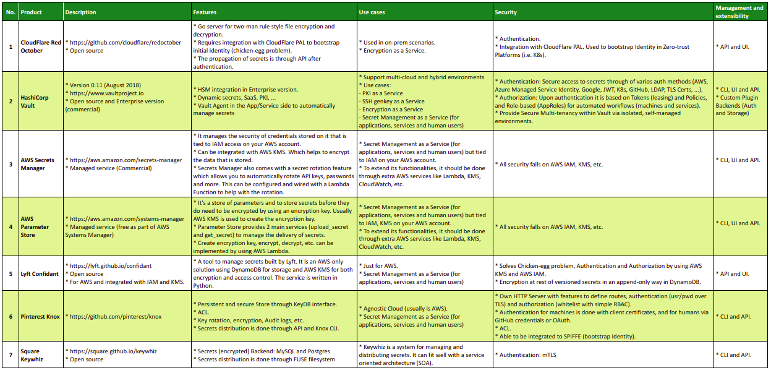
3. Products review

